Slide 1
PREDICTING CLIENT SUBSCRIPTION TO BANK TERM DEPOSITS - A BINARY CLASSIFICATION
A Capstone Project - by Chamila Wijayawardhana

Slide 2
About the project
This is a binary classification problem where the goal is to predict if a client will subscribe to a term deposit or not.
The data is related to direct marketing campaigns of a Portuguese banking institution. The marketing campaigns were based on phone calls.
Initial analysis of the data revealed there is a significant class imbalance with a 88 : 12 split of the majority class (‘no’ to term deposit) and the minority class (‘yes’ to term deposits).
Hence this problem is identified as a binary classification problem with a class imbalance.

Slide 3
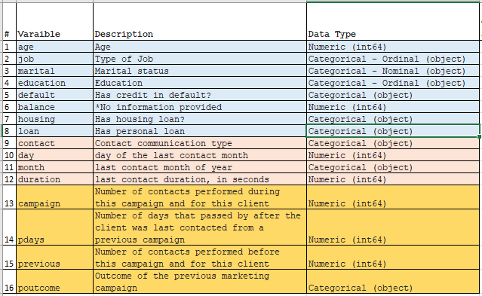
Feature Variables
Data set comprises of 16 input variable and 45211 instances
Are of 3 different types
Related bank client data
Related to the last contact of the current campaign
Related to current campaign and the previous campaigns
Consists of both “Numerical” and ‘Categorical’ variables

Slide 4
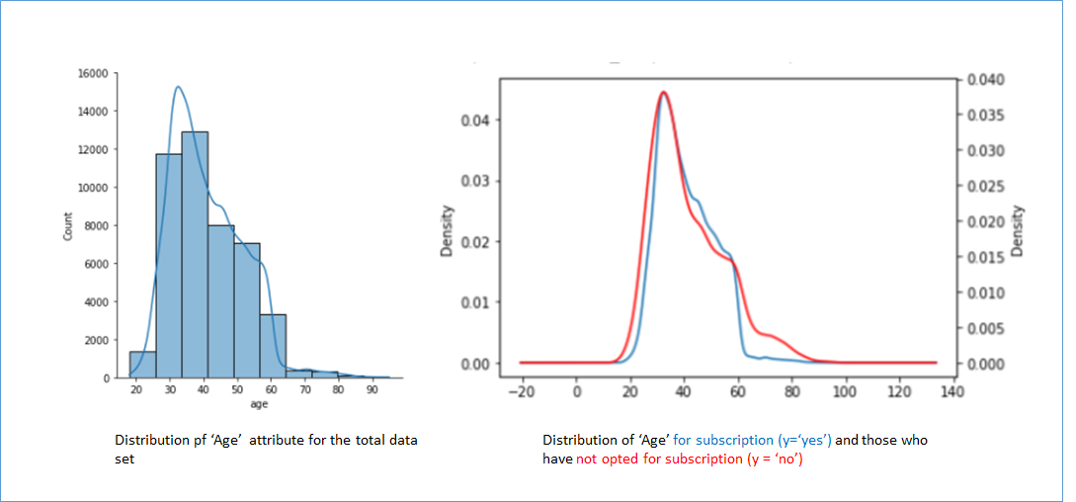
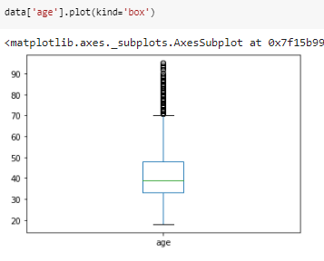
Findings from Descriptive Statistics
Following numerical variables are analyzed - : (a) Age, (b) Balance, (c) Campaign, (d) Pdays and (e) Previous.
The numerical attributes that were analyzed do not have ‘null’ values.
Analyses of the ‘age’ variable for the population and for the clients who have subscribed for (y = ‘yes’) and not subscribed y=’no’) revealed that they have similar probability distributions
Analyses of the ‘balance’ attribute revealed that clients who subscribed to the term deposit (y = ‘yes’) either had minus or lower account balances.
Analyses of the ‘pdays’ and ‘previous’ attributes revealed that majority of the clients (82%) have not been contacted in the previous campaign
All of the variables have a significant number of ‘outliers’

Slide 5
Exploring Categorical Variables
Following categorical variables were identified from the data set : (a) Job, (b) Marital, (c) Education, (d) Default, (e) Housing, (f) Loan (g) Contact, (h) Month (i) poutcome
Analysis of these attributes revealed there are a significant number of “unknown” values associated. These values are treated as null values.
For the ‘job’ and ‘education’ attributes, these null values are replaced with the highest frequency category of each of the attributes.
The ‘poutcome’ attribute (Outcome of the previous marketing campaign) has 82% of unknown values and hence will not be considered for building the machine learning model.

Slide 6
Data Pre-processing / Feature Engineering
Treatment of numerical variables
All the numerical variables were standardized on Z-score normalization as the probability distributions of all these variables are skewed.
Treatment of categorical variables
Replacement of null values - Null values in ‘job’ and ‘education’ are imputed by the most frequently occurring category for each attribute.
Grouping - There are 11 different job categories as listed in the data set and they are grouped into 3 categories as follows, Job_category1 - {unemployed, students, housemaids} , Job_category 2 - {bluecollar, technician, services, admin, retired}, Job_category 3 - {management, self employed,entrepreneur}
Encoding - All of the selected categorical variables are one-hot encoded for building the machine learning model
Consideration correlation of attributes with the target variable, following numerical and categorical attributes were selected for the initial model building : 'age','balance','campaign','previous', 'job_group', 'education', 'default', 'housing', 'loan'

Slide 7
Model selection and Training
As there is significant class imbalance in this classification problem, with with class 0 ( y = no ) and class 1 ( y = yes ) having 88 : 12 percent split, ‘Random Forest’ algorithm is primarily selected for building the machine learning model as its ensemble properties may assist in negating the the imbalance.
Model was trained on a 70 : 30 split of training and testing data.
As the problem is that of a class imbalance the training data set was resampled using the Random Undersampling technique for the majority class.
However this resampling did not improve the model performance for both the classes and for further processing in the pipeline the original train test split was retained.

Slide 8
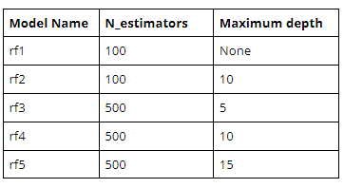
Hyperparameter tuning and selecting the best model
For the purpose of selecting the best model (parameters) , multiple Random Forest classifiers with the below listed hyper parameters were tested.
N_estimators: The number of trees in the forest
The maximum depth of the tree. If None, then nodes are expanded until all leaves are pure or until all leaves contain less than min_samples_split samples.
Alternatively a grid search based cross validation was also performed on the model to select/validate the optimal parameters.

Slide 9
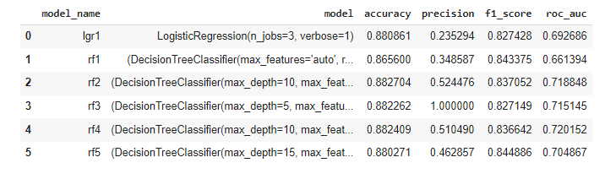
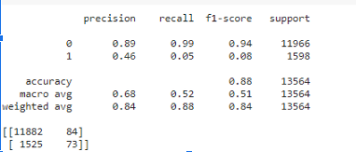

Model Evaluation
As this is a binary classification problem with a class imbalance, model accuracy will not be considered as an evaluation metric. Only the (a) model precision, (b) f1 score and the (c) ROC AUC (Area under the ROC Curve) metrics are considered for evaluating the best model.
From manual hyperparameter tuning, the evaluation table was obtained.
Confusion matrix
Model performs well on the majority class, but performs rather poorly on the minority class
Random Forest Classifier - ‘rf2’ is selected as the best model.
By cross validation with grid search

Slide 10
Model deployment and Explaining the machine learning model
As part of this exercise following components were developed which can be used to create an inference pipeline for the purpose of model deployment
Pre-processing function
Machine Learning model (which is saved using “Joblib” and “pickle”)
Predict / Scoring function
Post processing function
Additionally the following component can be further developed to create an end to end machine learning solution.
A user interface to get input data
API that takes in user inputs and invoke the inference pipeline (listed above)
An output user interface that displays the output from the inference pipeline. The output can also be further improved by analysing the output with LIME or SHAP and giving end users the reasons / factors that contributed to the predicted output.
The solution can be deployed either locally or on cloud infrastructure, either on virtualized or containerized hardware depending on the particular client requirements.

